Slide 1
AMIC by Bayes by Backprop
Leon King

Slide 2
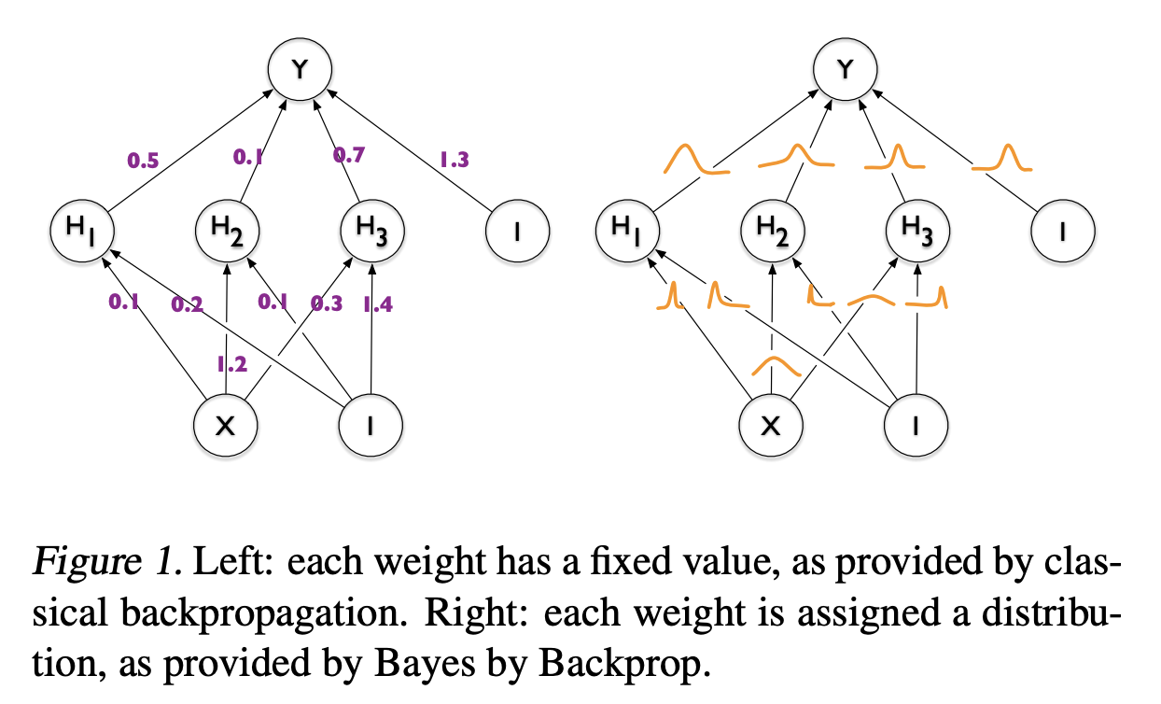
Bayes Neural Network Idea

Slide 3
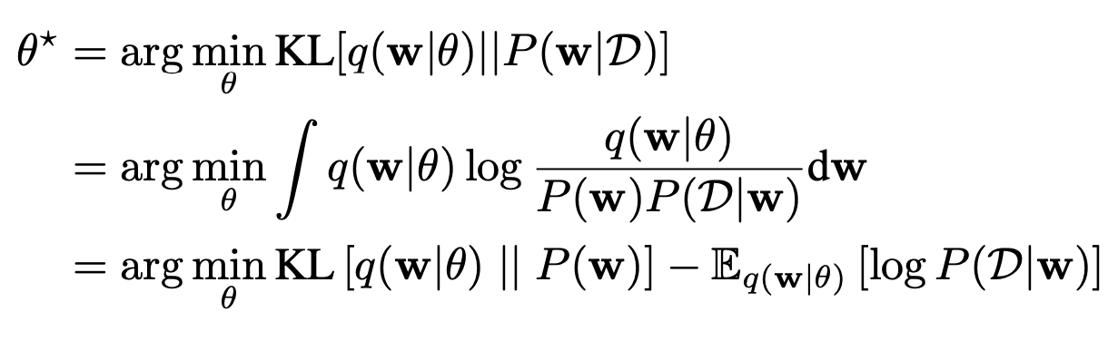
Kullback-Leibler (KL) Divergence between True Posterior and Appro. Post
The core idea of Bayesian Variational is using a known distribution to approximate the true intractable posterior distribution in neural network.

Slide 4
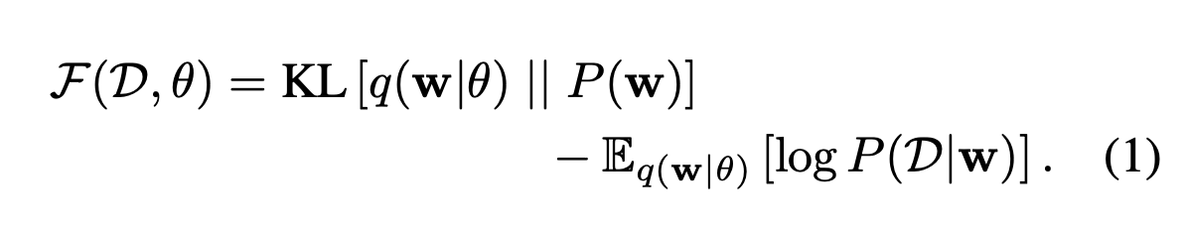
The cost function
The cost function embodies a trade-off between satisfying the complexity of the data D and and satisfying the simplicity prior P(w).

Slide 5
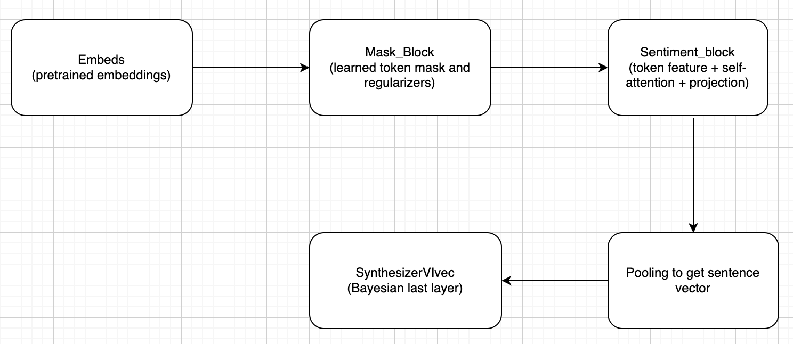
Overall Architecture

Slide 6
Detailed Structure
https://app.diagrams.net/ - G160A9dS0rofL1ECgT9v0Bt_dTWmPT3JiW

Slide 7
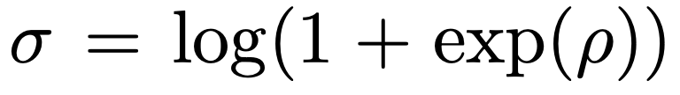
The Last Bayesian Layer for AMIC
The prior for weights and bias is N(0, sigma^2)
The conjugate posterior for weights and bias is also Gaussian N(mu, rho)
Here unconstrainted rho is used to represent the sigma
The Softplus transformation function is used to transform rho from any real value to a positive standard deviation

Slide 8
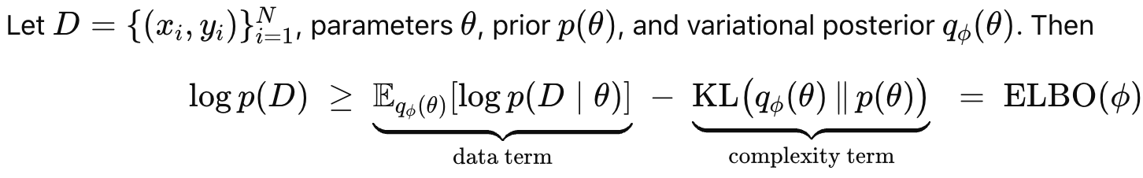
Max Evidence lower bound

Slide 9
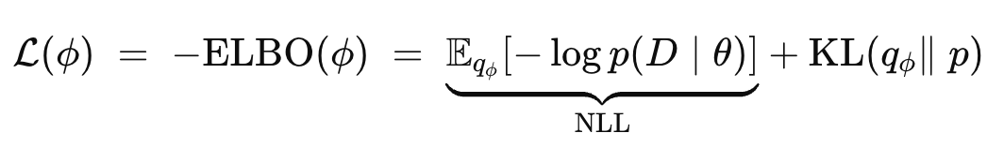
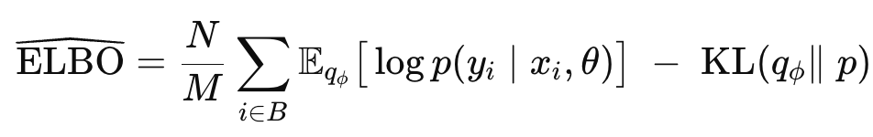
Min Negative ELBO:
Max for a minibatch B of size M in neural network:

Slide 10
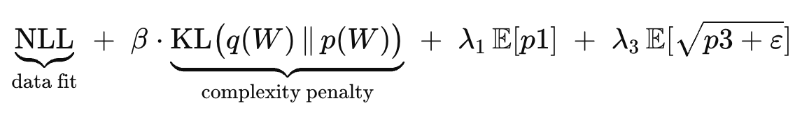
Training objects: mini beta-ELBO with p1 and p3 regularization terms
NLL: likelihood data fit
KL: measure the difference between true posterior and approximate posterior
Beta: linear anneal

Slide 11
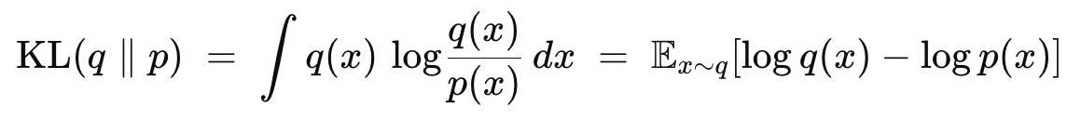
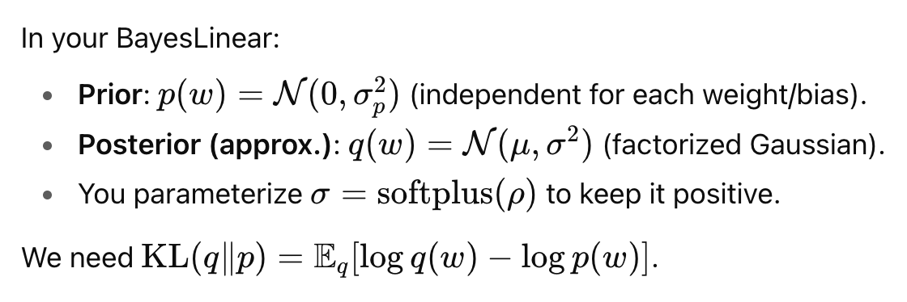
Definition of KL
Non-negative
Asymmetric

Slide 12
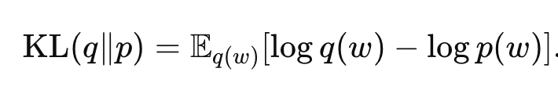
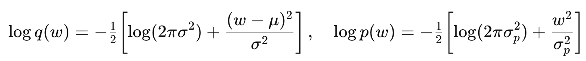
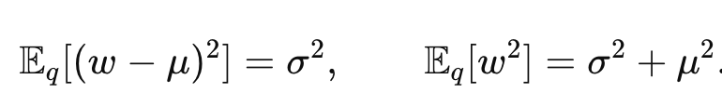
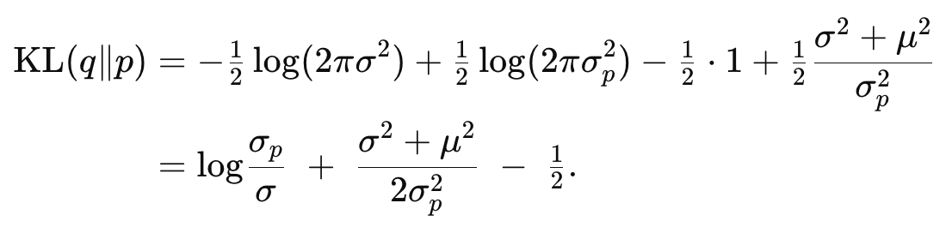
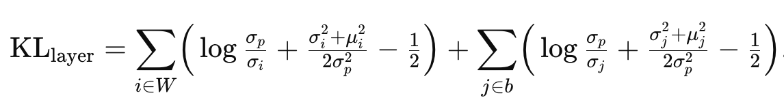
Derivation of KL in the model

Slide 13
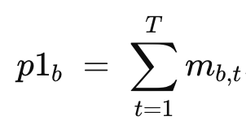
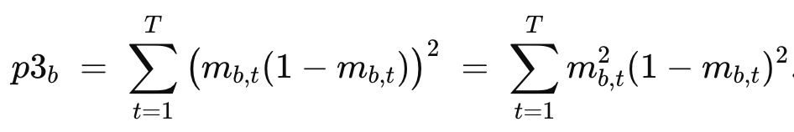
Two Penalty Terms: p1 and p3
P1 is sparsity penalty:
Minimizing this encourages fewer tokens “on” (small masks)
P3 is peaked-ness penalty:
Minimizing its square pushes each token’s gate m to either 0 and 1

Slide 14
Compute loss in code
nll = BCEWithLogitsLoss(logits, labels)
kl = mb3.kl()
loss = nll + beta*kl + 0.01*mean(p1) + 0.02*mean(sqrt(p3+eps))

Slide 15
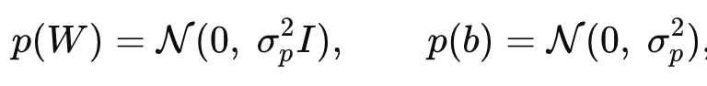
New Class: Bayesian Layer
class BayesLinear(nn.Module):
"""Factorized Gaussian posterior; prior N(0, sigma_p^2 I)."""
def __init__(self, in_features, out_features, prior_sigma=1.0, init_rho=-3.0):
super().__init__()
self.weight_mu = nn.Parameter(torch.zeros(out_features, in_features))
self.weight_rho = nn.Parameter(torch.full((out_features, in_features), float(init_rho)))
self.bias_mu = nn.Parameter(torch.zeros(out_features))
self.bias_rho = nn.Parameter(torch.full((out_features,), float(init_rho)))
self.register_buffer("prior_sigma", torch.tensor(float(prior_sigma)))
@property
def weight_sigma(self):
return F.softplus(self.weight_rho) + 1e-8
@property
def bias_sigma(self):
return F.softplus(self.bias_rho) + 1e-8
def kl(self) -> torch.Tensor:
w_mu, w_sigma = self.weight_mu, self.weight_sigma
b_mu, b_sigma = self.bias_mu, self.bias_sigma
p_sigma = self.prior_sigma
kl_w = torch.log(p_sigma / w_sigma) + (w_sigma**2 + w_mu**2) / (2 * p_sigma**2) - 0.5
kl_b = torch.log(p_sigma / b_sigma) + (b_sigma**2 + b_mu**2) / (2 * p_sigma**2) - 0.5
return kl_w.sum() + kl_b.sum()
def forward(self, x, sample: bool = True):
if self.training or sample:
W = self.weight_mu + self.weight_sigma * torch.randn_like(self.weight_mu)
b = self.bias_mu + self.bias_sigma * torch.randn_like(self.bias_mu)
else:
W, b = self.weight_mu, self.bias_mu
return F.linear(x, W, b)
set Gaussian prior: self.register_buffer("prior_sigma", torch.tensor(float(prior_sigma)))
Approximated posterior distributions: self.weight_mu, self.weight_rho
self.bias_mu, self.bias_rho def weight_sigma(self): return F.softplus(self.weight_rho) + 1e-8
def bias_sigma(self): return F.softplus(self.bias_rho) + 1e-8

Slide 16
Sample from q to get uncertainty in forward pass
if self.training or sample:
W = self.weight_mu + self.weight_sigma * torch.randn_like(self.weight_mu)
b = self.bias_mu + self.bias_sigma * torch.randn_like(self.bias_mu)
else:
W, b = self.weight_mu, self.bias_mu

Slide 17
Compute the KL divergence
class SynthesizerVIvec(nn.Module):
"""
Bayesian head that consumes a vector sentence embedding [B, S] (+ optional digits).
"""
def __init__(self, feature_dim, digits_dim=0, prior_sigma=1.0, dropout_p=0.1):
super().__init__()
self.feature_dim = feature_dim
self.digits_dim = int(digits_dim)
self.dropout = nn.Dropout(dropout_p)
self.bayes_head = BayesLinear(feature_dim + self.digits_dim, 1, prior_sigma=prior_sigma)
def forward(self, h_vec, digits=None, sample=True):
# h_vec: [B, S]
x = self.dropout(h_vec)
if digits is not None and self.digits_dim > 0:
x = torch.cat([x, digits], dim=1) # [B, S + Dg]
logits = self.bayes_head(x, sample=sample).squeeze(-1) # [B]
probs = torch.sigmoid(logits)
return probs, logits
def kl(self):
return self.bayes_head.kl()
kl_w = torch.log(p_sigma / w_sigma) + (w_sigma**2 + w_mu**2) / (2*p_sigma**2) - 0.5
kl_b = torch.log(p_sigma / b_sigma) + (b_sigma**2 + b_mu**2) / (2*p_sigma**2) - 0.5
KL = kl_w.sum() + kl_b.sum()

Slide 18
Optimizer and Scheduler
optimizer1 = torch.optim.AdamW(mb1.parameters(), lr=lr1, eps=1e-8, weight_decay=1e-4)
optimizer2 = torch.optim.AdamW(mb2.parameters(), lr=lr2, eps=1e-8, weight_decay=1e-4)
optimizer3 = torch.optim.AdamW(mb3.parameters(), lr=lr3, eps=1e-8, weight_decay=1e-4)
optimizer0 = torch.optim.AdamW(mb0.parameters(), lr=lr0, eps=1e-8, weight_decay=1e-5)
scheduler1 = CosineAnnealingLR(optimizer1, T_max=epochs, eta_min=lr1*0.01)
scheduler2 = CosineAnnealingLR(optimizer2, T_max=epochs, eta_min=lr2*0.01)
scheduler3 = CosineAnnealingLR(optimizer3, T_max=epochs, eta_min=lr3*0.01)
scheduler0 = CosineAnnealingLR(optimizer0, T_max=epochs, eta_min=lr0*0.1)

Slide 19
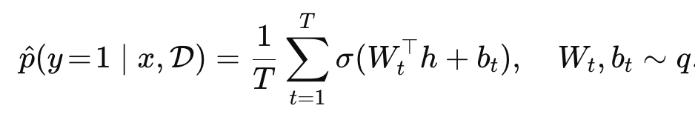
Prediction Uncertainty: Monte Carlo Samping
q is the approximated posterior distribution

Slide 20
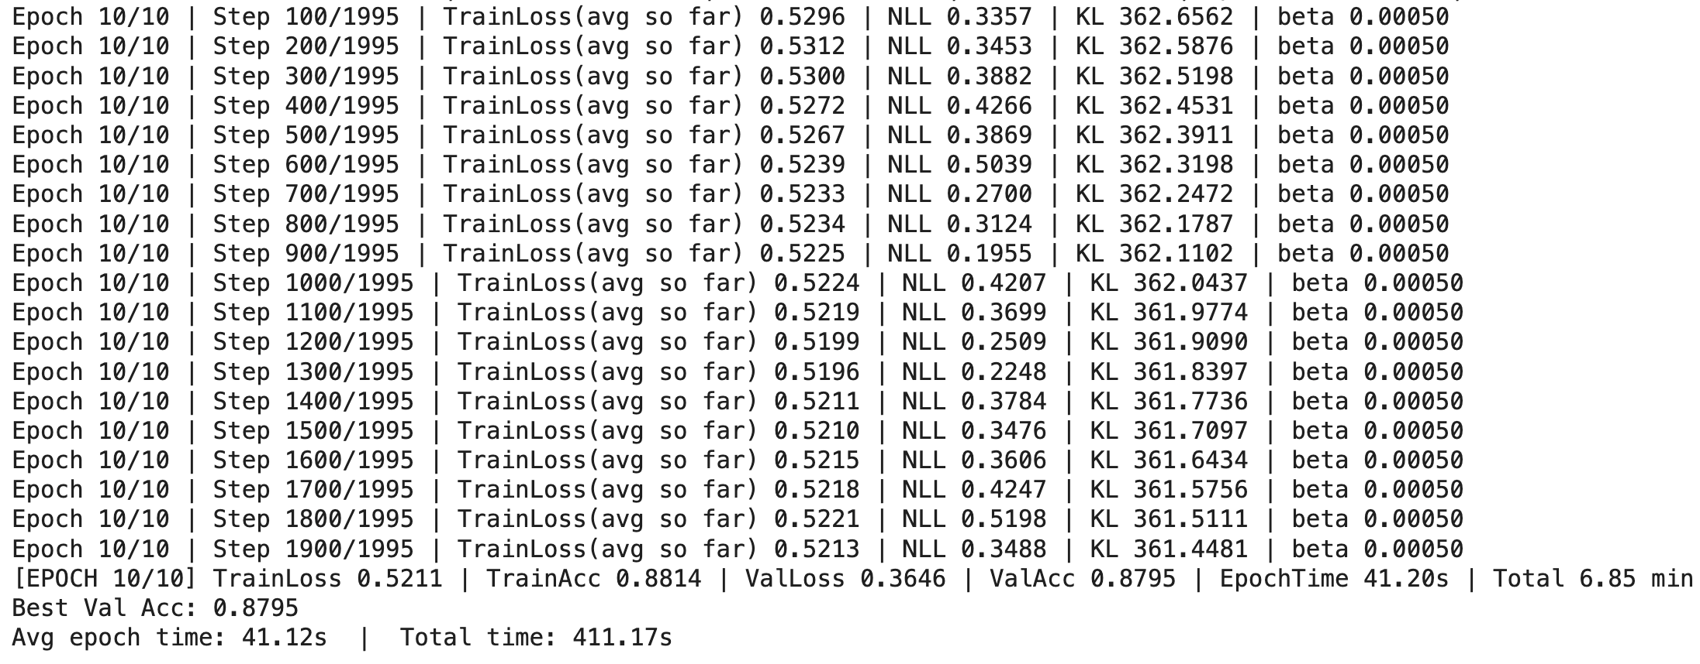
Training

Slide 21
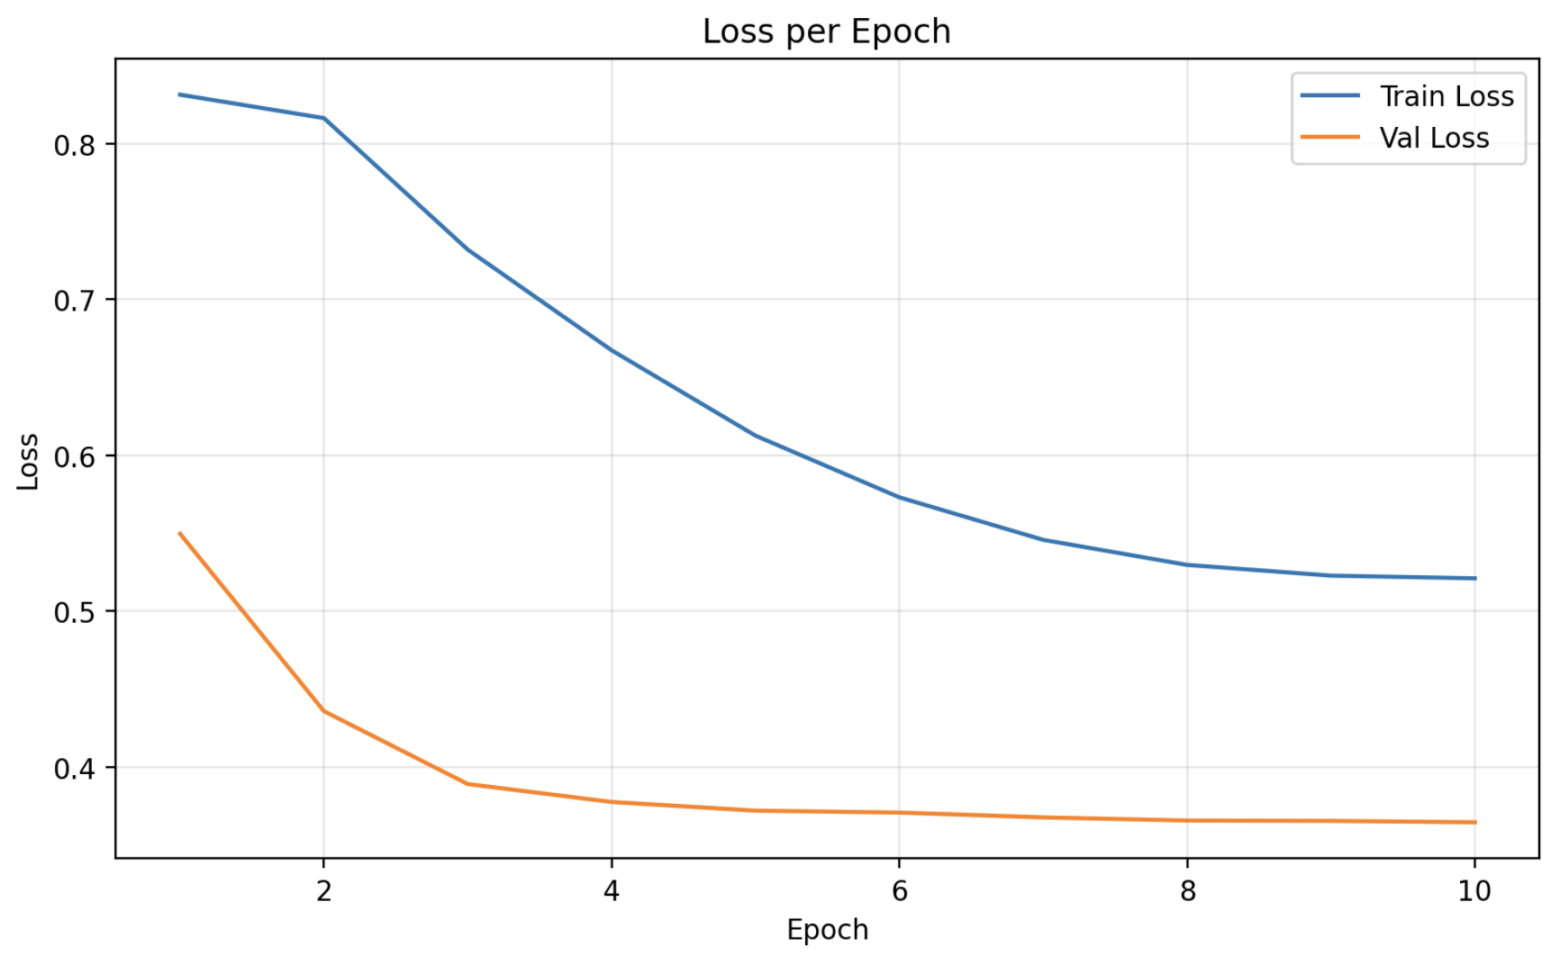
Results

Slide 22
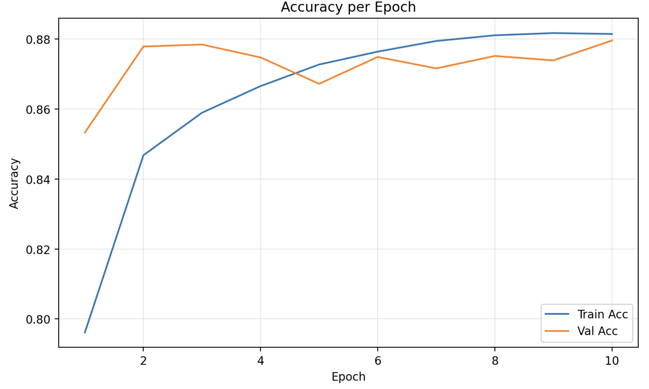
Results

Slide 23
Evaluate with best threshold from VALIDATION
[VALID] Best threshold by accuracy: 0.675 (val acc at that thr ≈ 0.8854)
[TRAIN metrics] {'threshold': 0.675, 'acc': 0.891063596491228
[VALID metrics] {'threshold': 0.675, 'acc': 0.8853693181818182
[TEST metrics] {'threshold': 0.675, 'acc': 0.8920454545454546

Slide 24
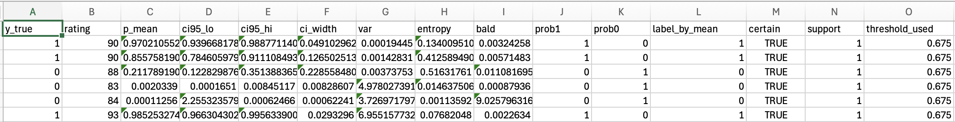
Tables: test, all inference are made from posterior samples

Slide 25
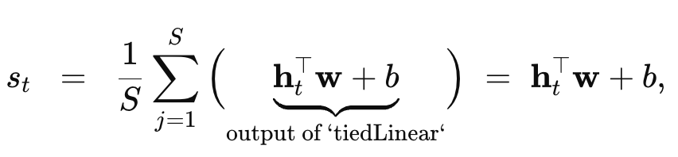
word-level sentiment score
There are two ways to compute the word-level sentiment score
The 1st way is to get directly scores from sentiment_block class: token features from this class multiples by token mask; h_t is the attention-refined token feature from SelfAttention + LayerNorm + Dropout.

Slide 26
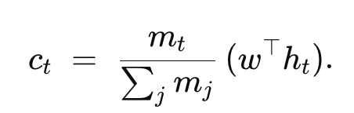
2nd way to compute sentiment scores
The 2nd way is to compute the sentiment scores from the Bayesian head at the final layer
Token features from the sentiment block: h_t
Padding mask: m_t either 0 or 1
Per-token logit contribution:

Slide 27
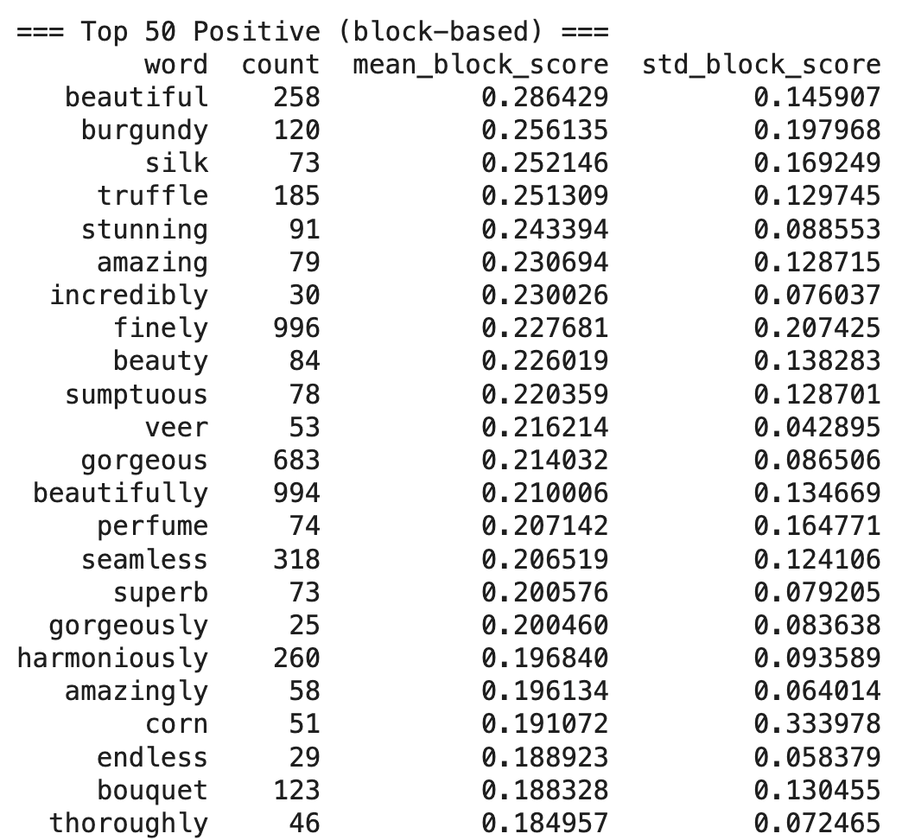
Top 50 Positive for block-based

Slide 28
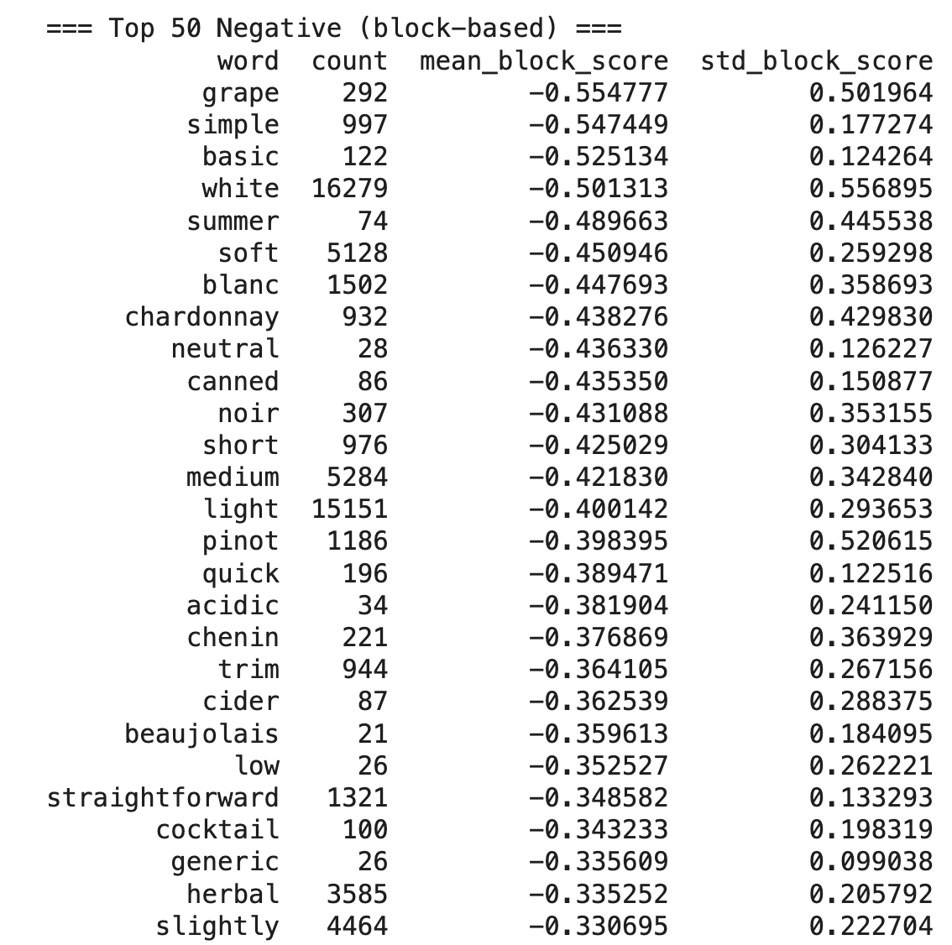
Top 50 Negative Block-based

Slide 29
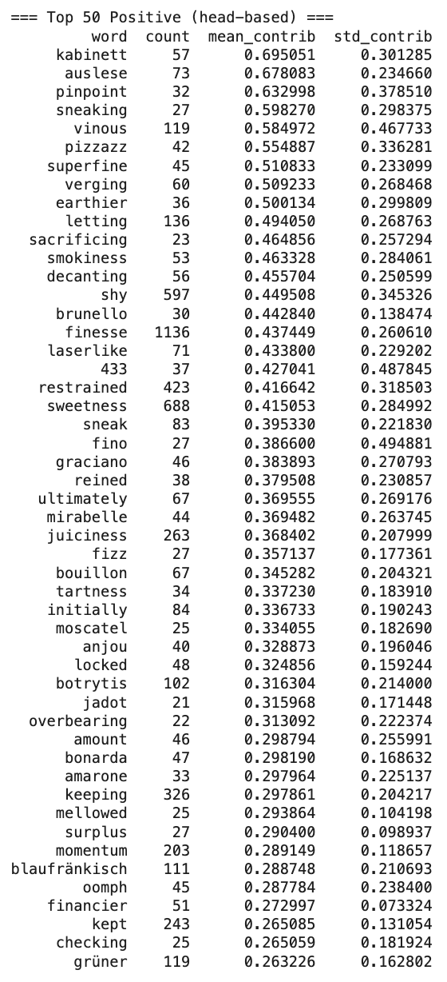
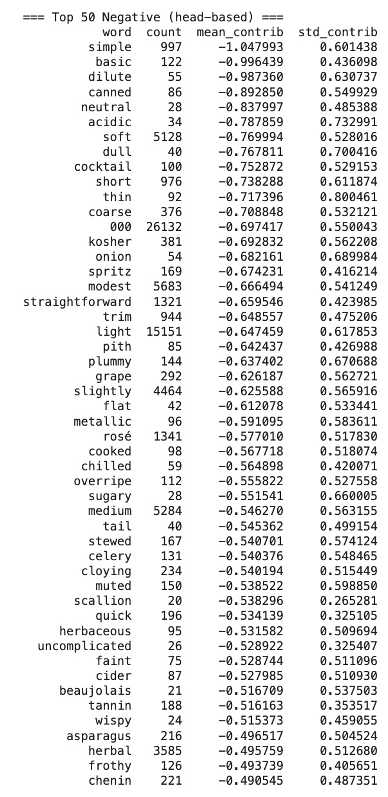
Top 50 Positive words for Bayesian head

Slide 30
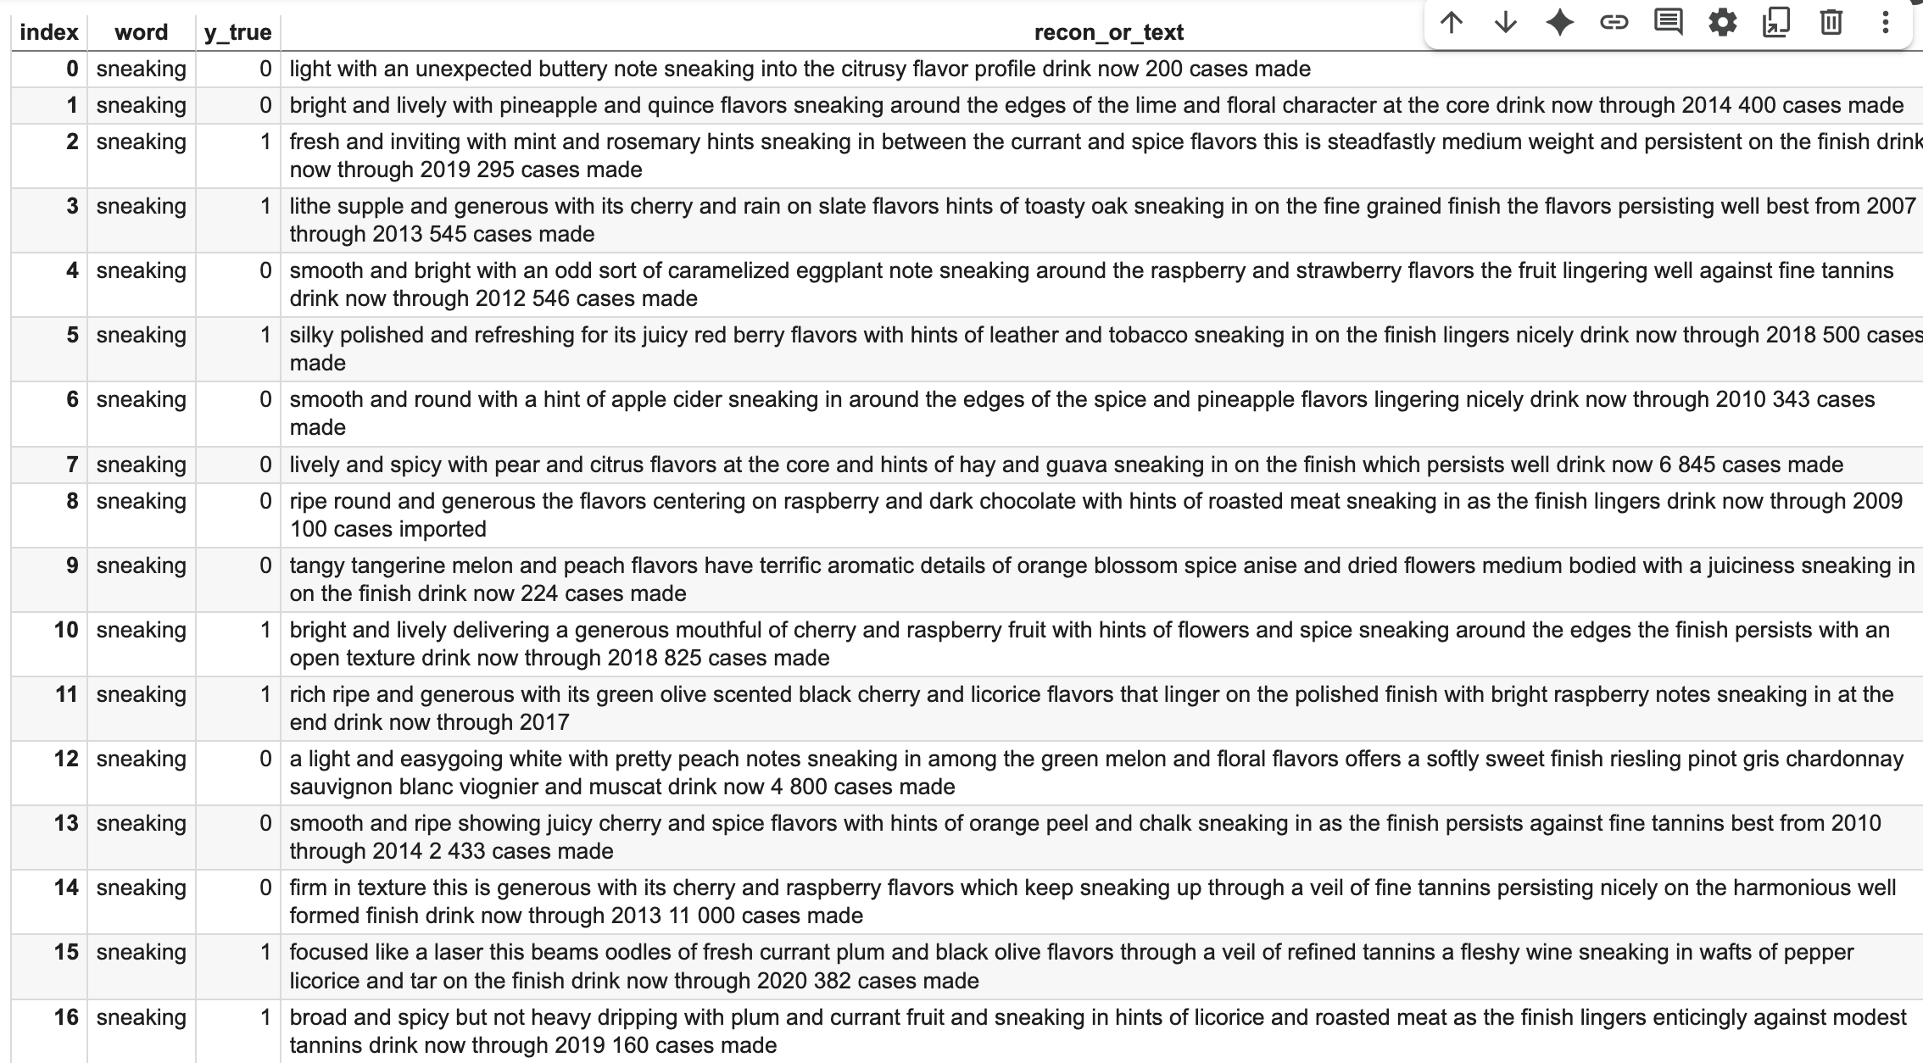
Wine Top Positive Word Analyze

Slide 31
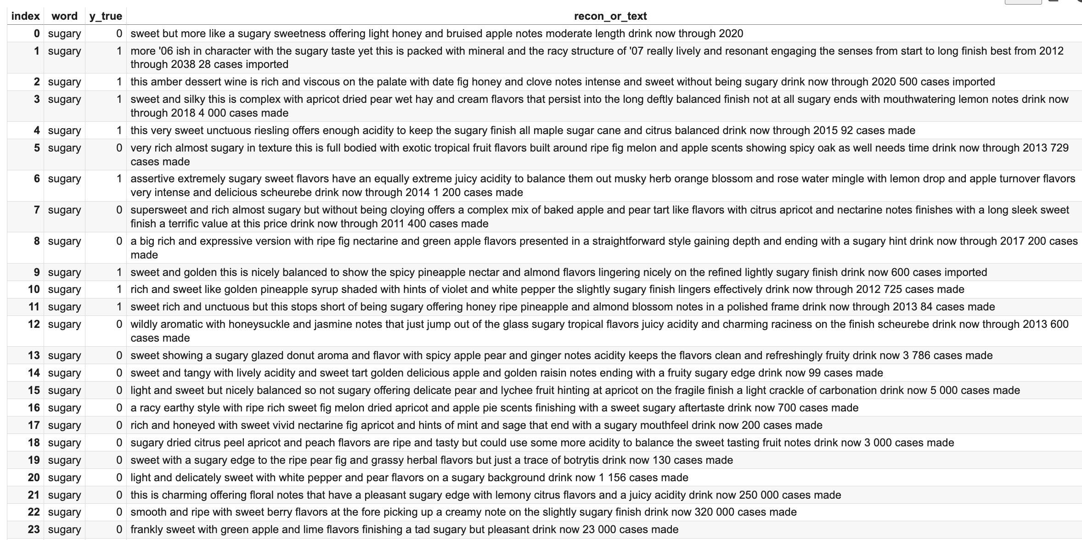
Wine Top Negative Word Analyze

Slide 32
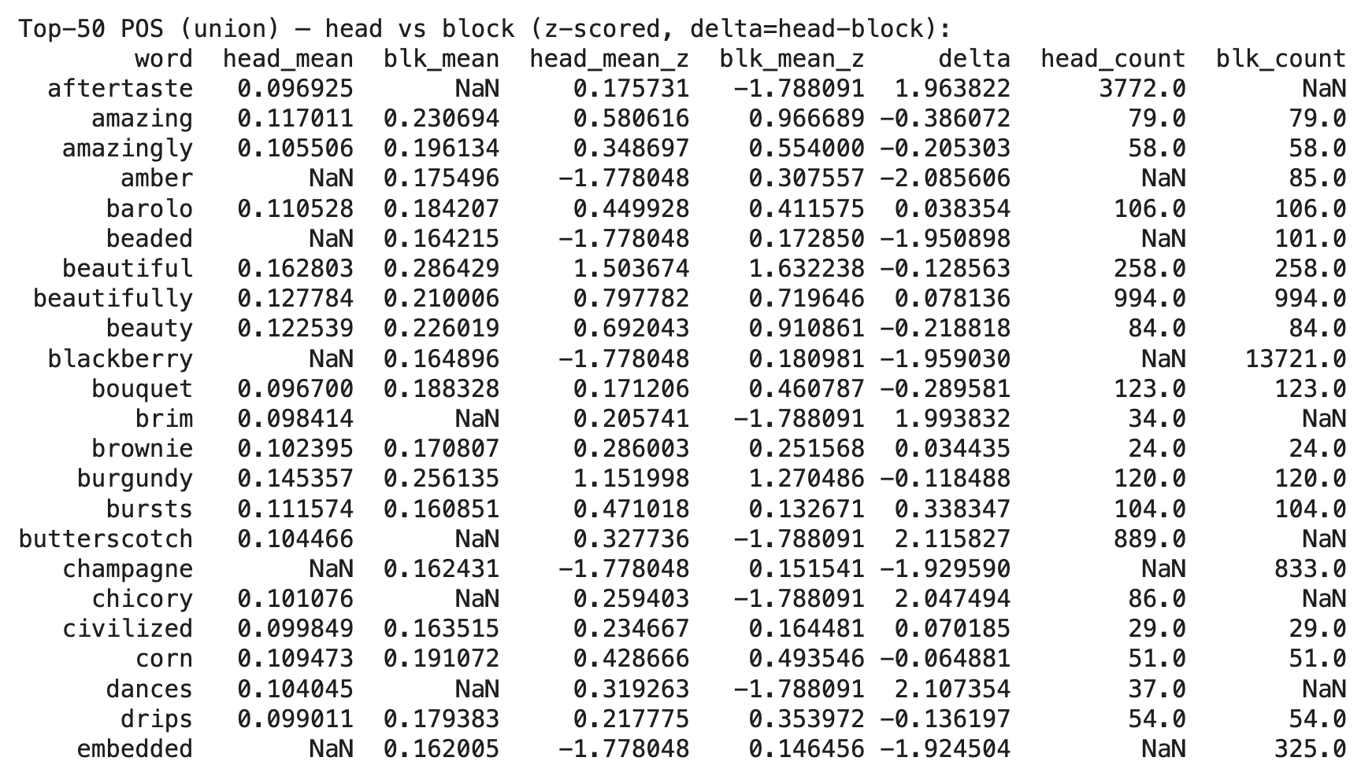
Comparison between two ways of sentiment scores

Slide 33
Try Bayesian AMIC on other dataset
I tried on different dataset
1. Amazon
2. IMDB Movie
3. Twitter

Slide 34
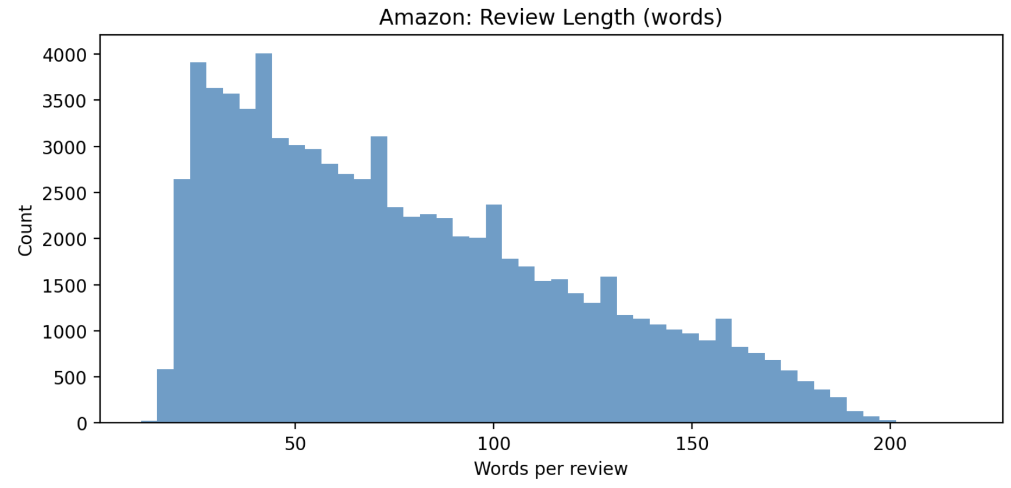
Amazon Dataset
80,000 rows in total

Slide 35
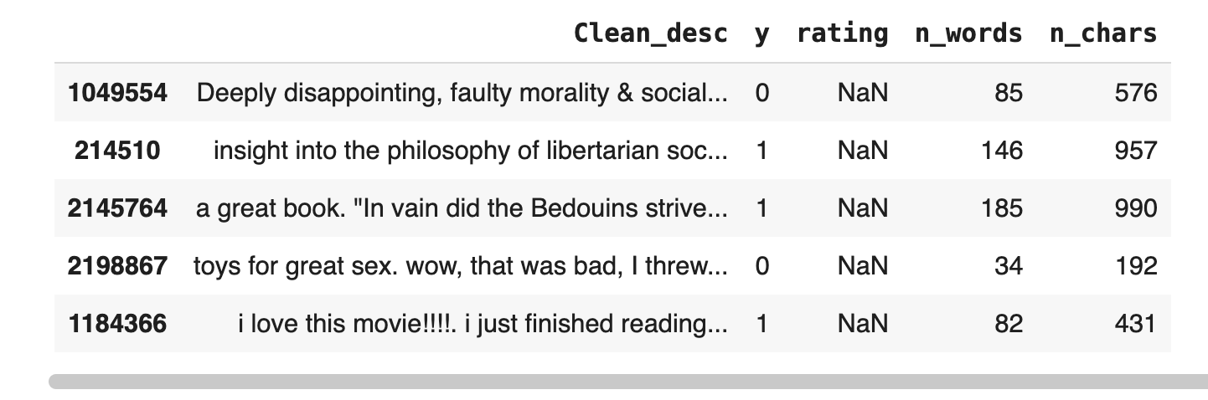
Amazon Dataset Snap

Slide 36
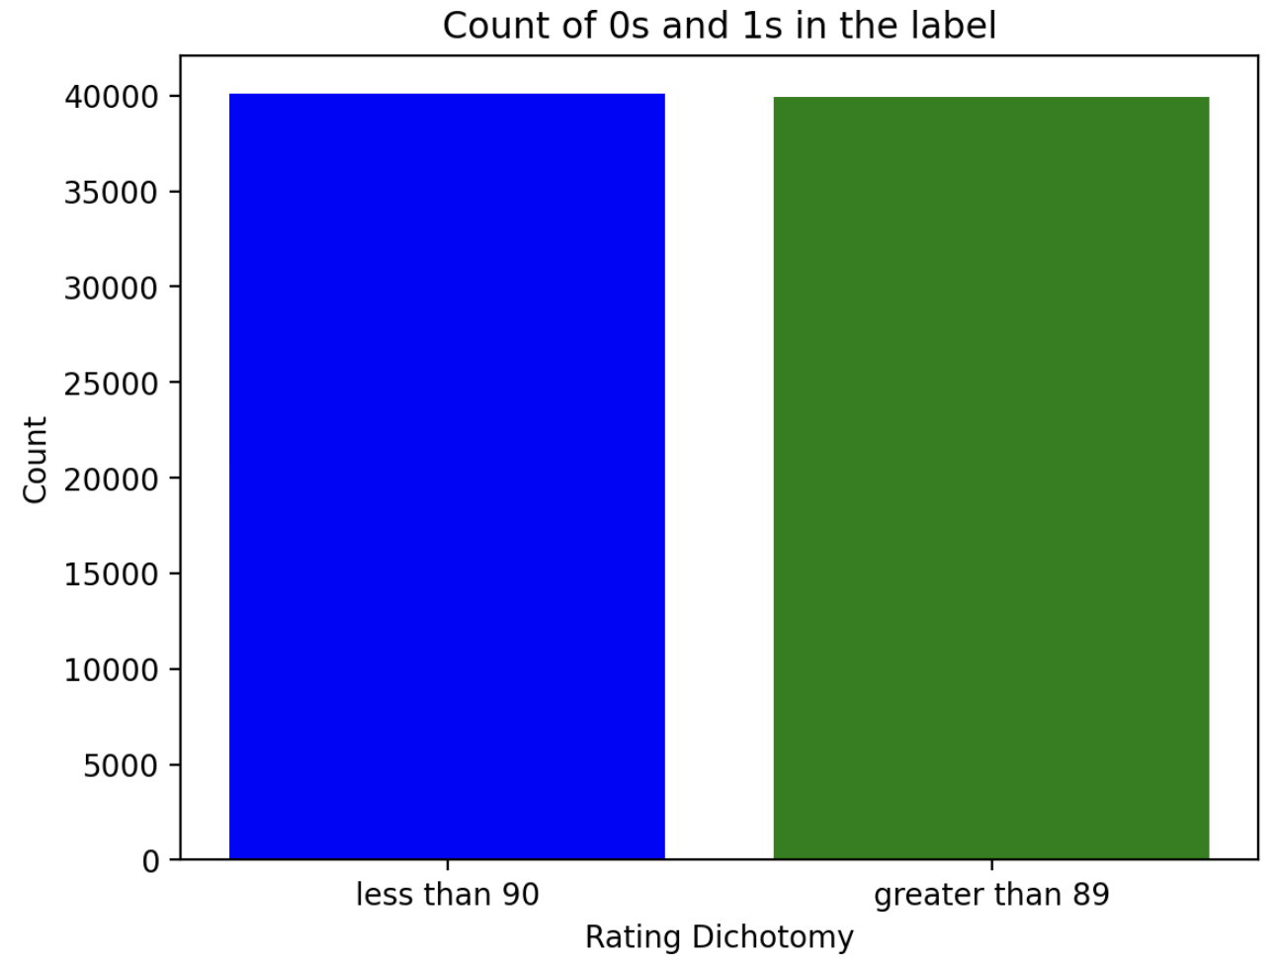
Amazon Data Label Balance

Slide 37
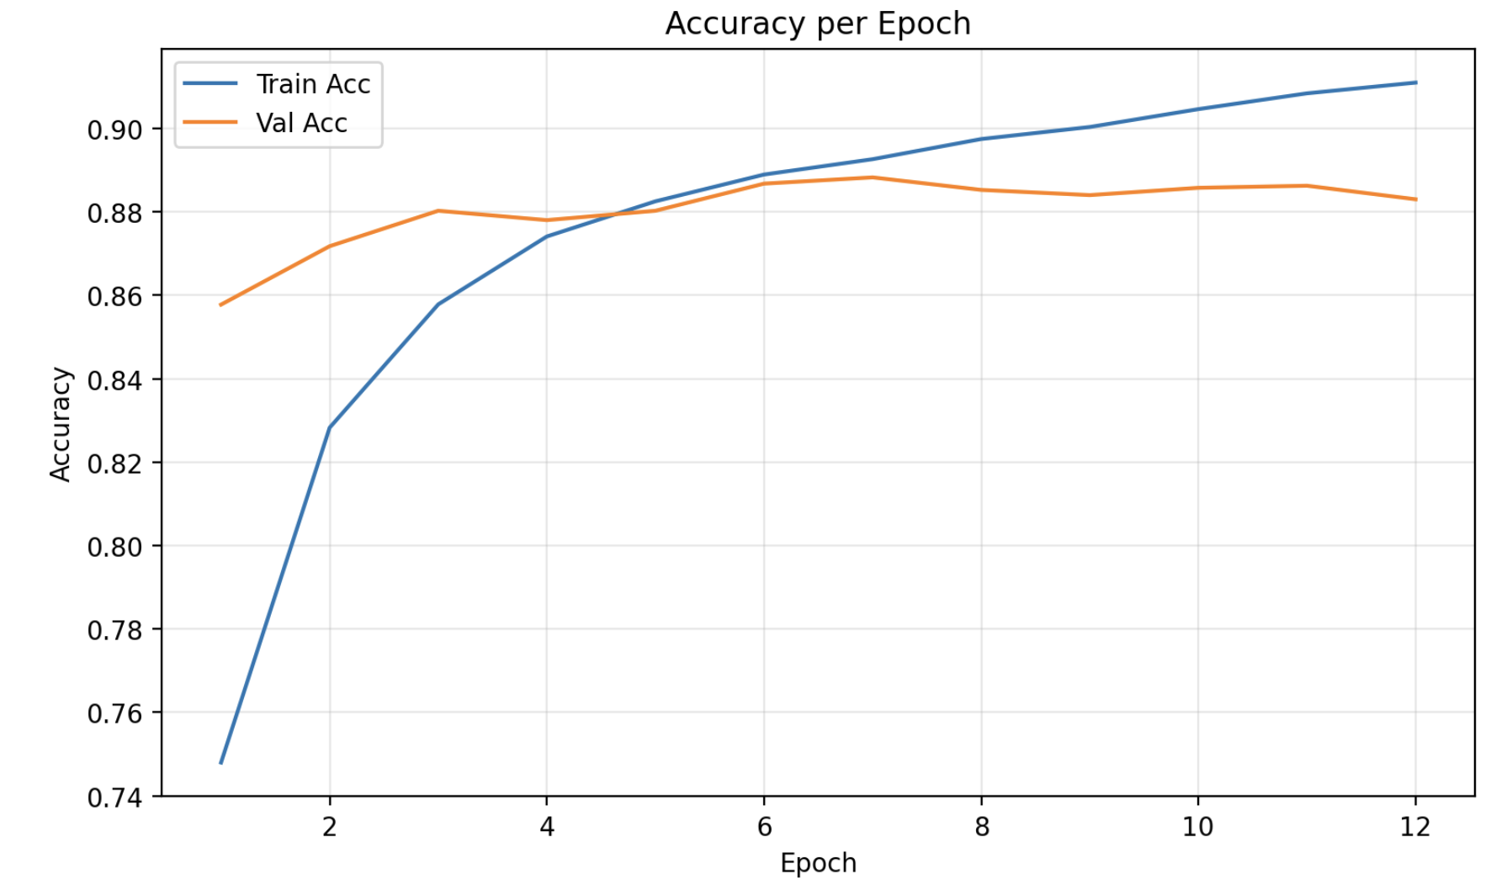
Amazon Training Accuracy

Slide 38
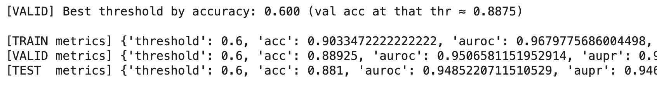
Amazon Training results

Slide 39
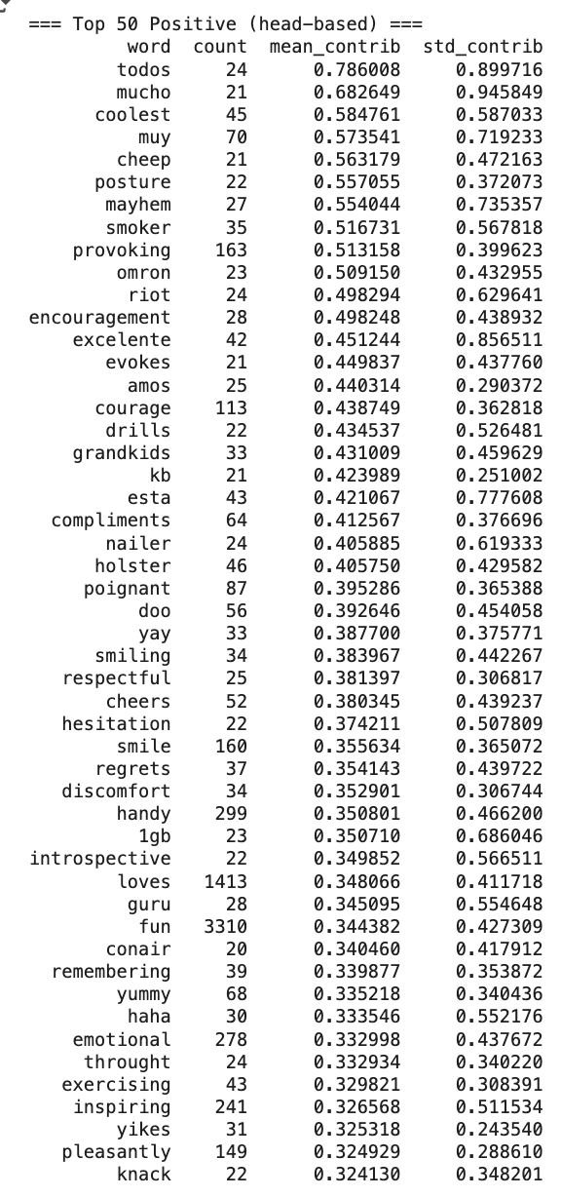
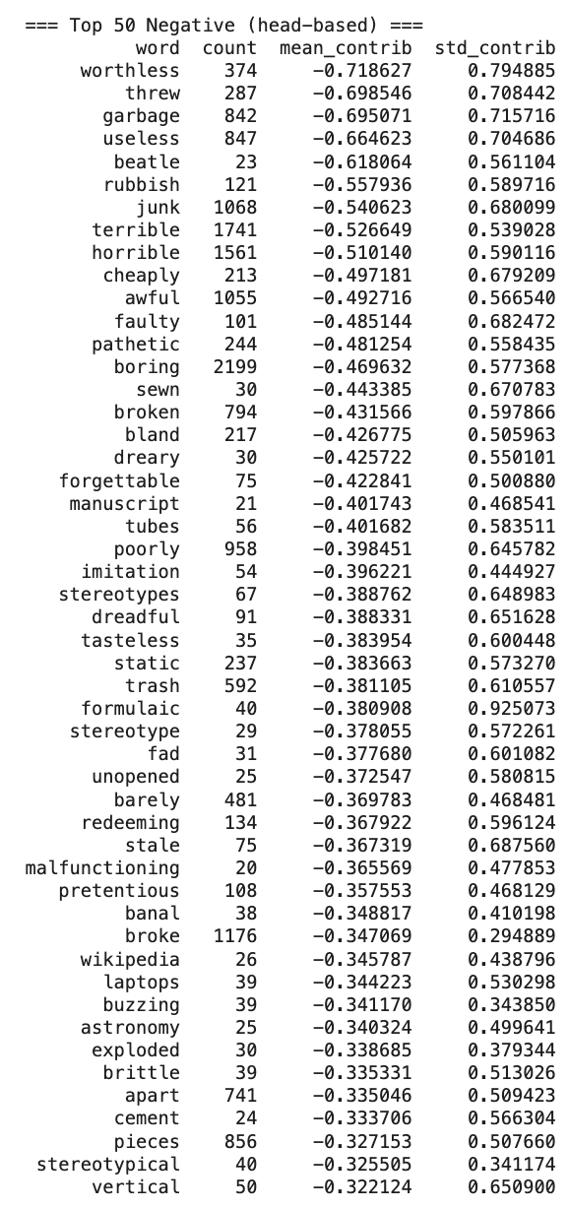
Amazon Top 50 Positive and Negative Words

Slide 40
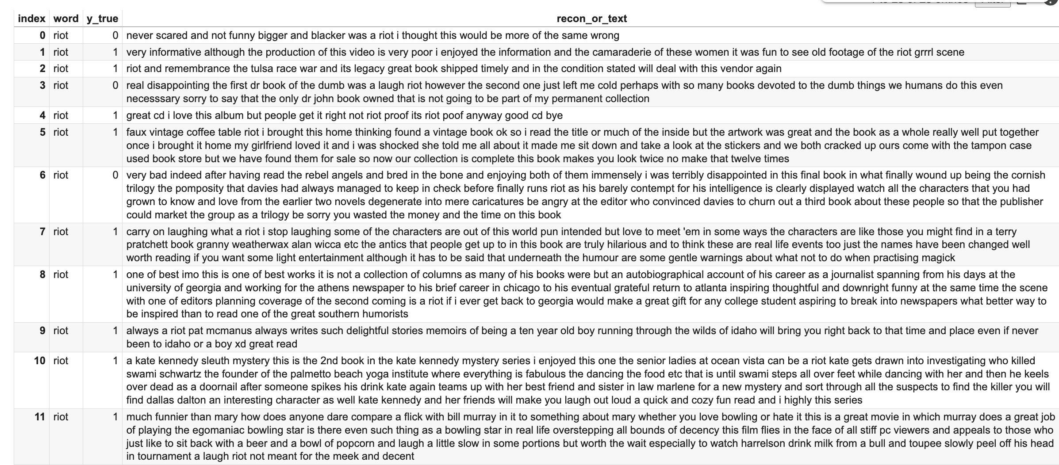
Amazon Top Positive Word Case Studies

Slide 41
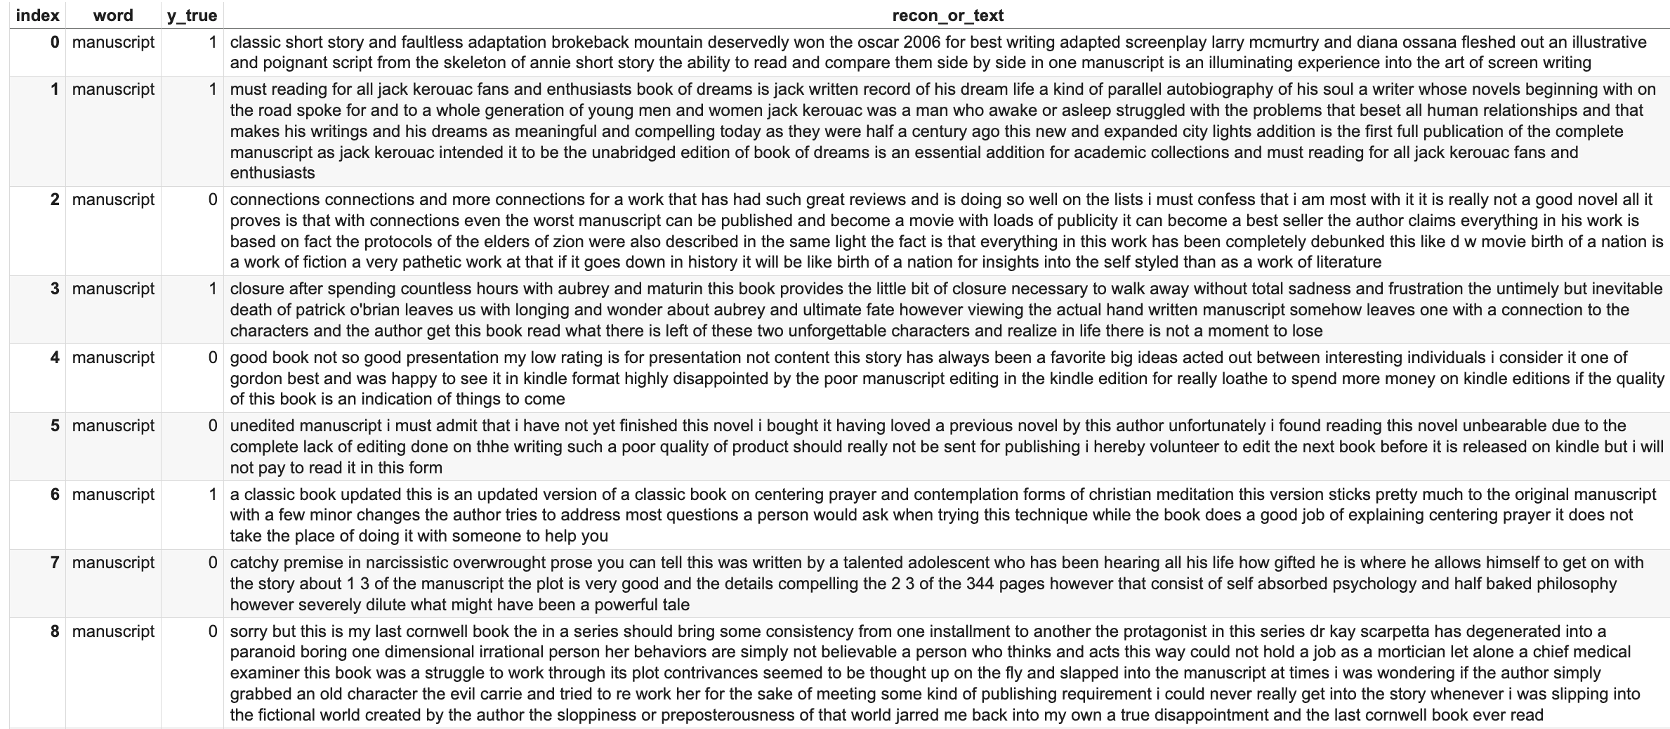
Amazon Top Negative Word Case Studies

Slide 42
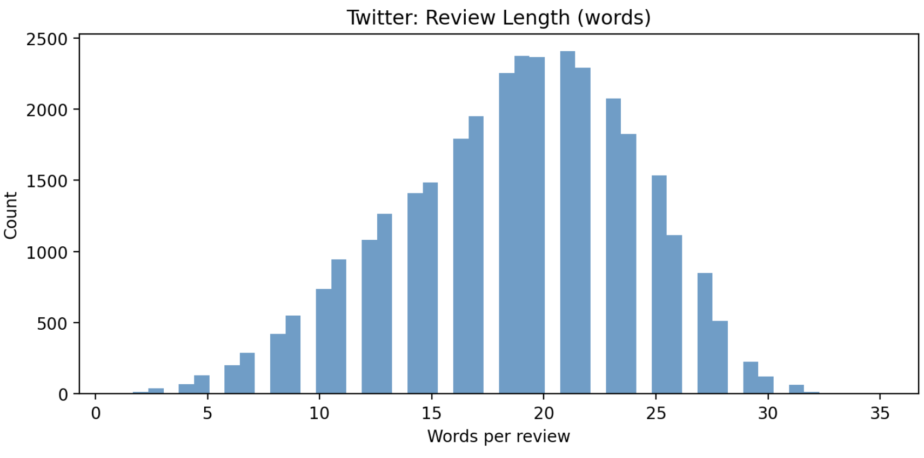
Twitter Dataset: 32420 rows

Slide 43
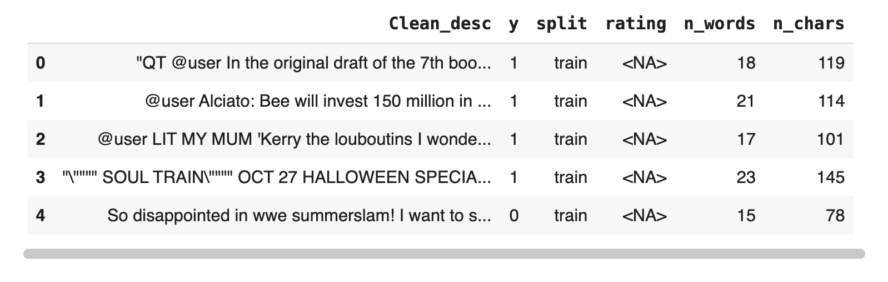
Twitter Dataset Snap

Slide 44
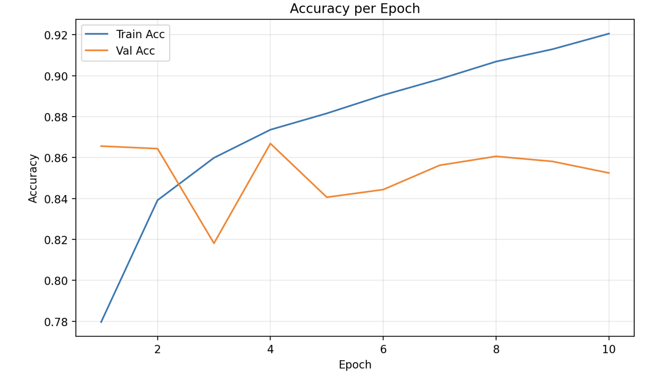
Twitter Training Accuracy

Slide 45
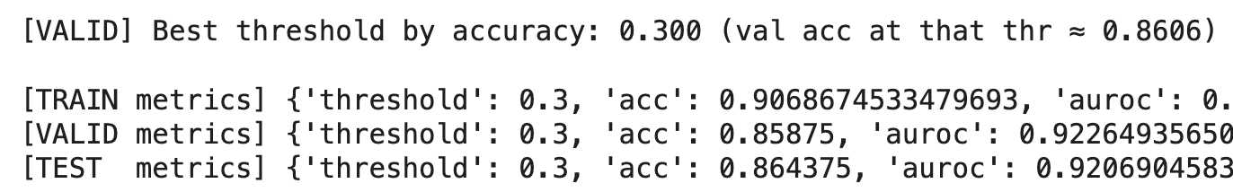
Twitter Training Results

Slide 46
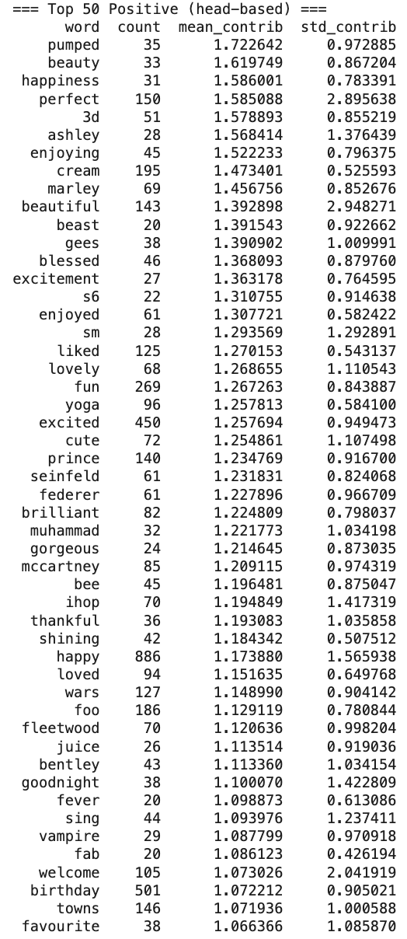
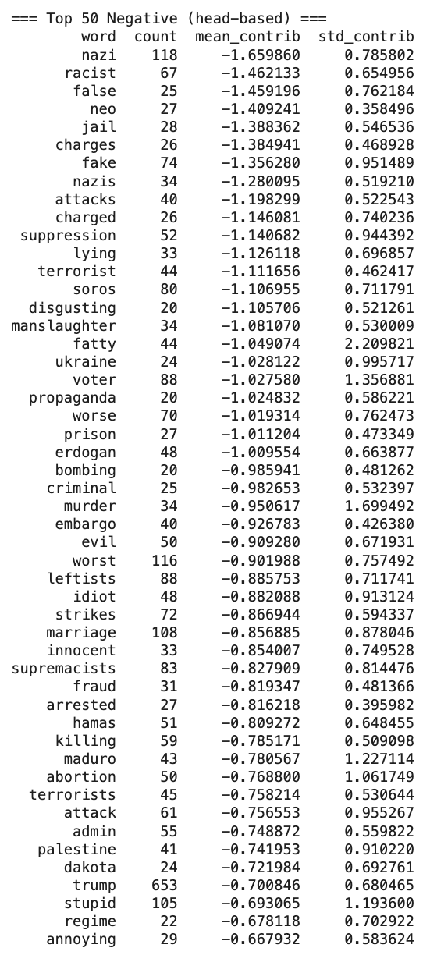
Twitter Top 50 Positive and Negative Words

Slide 47
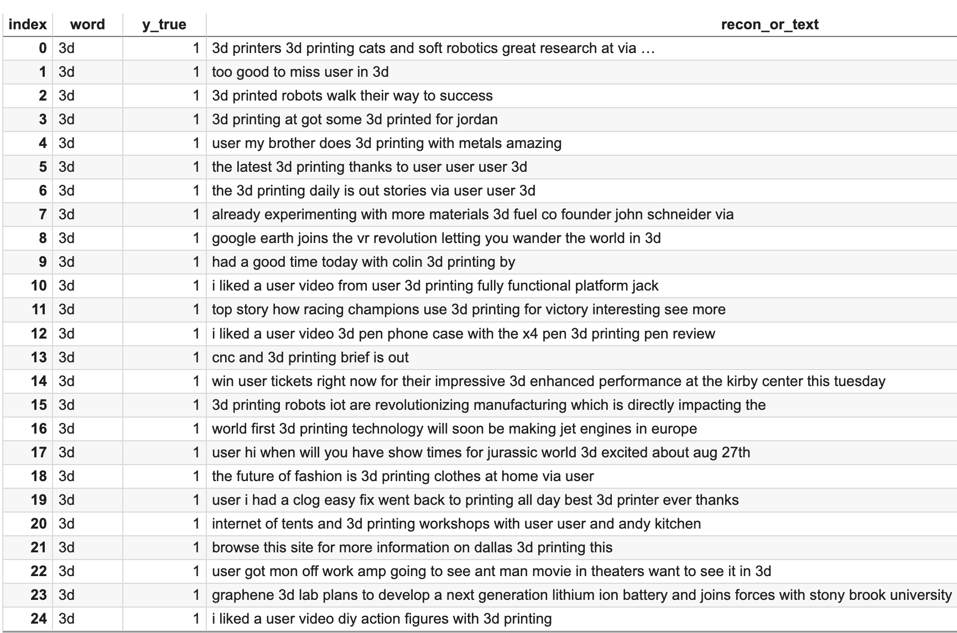
Twitter Top word case studies
Analyze ‘3d’ in top positive words:

Slide 48
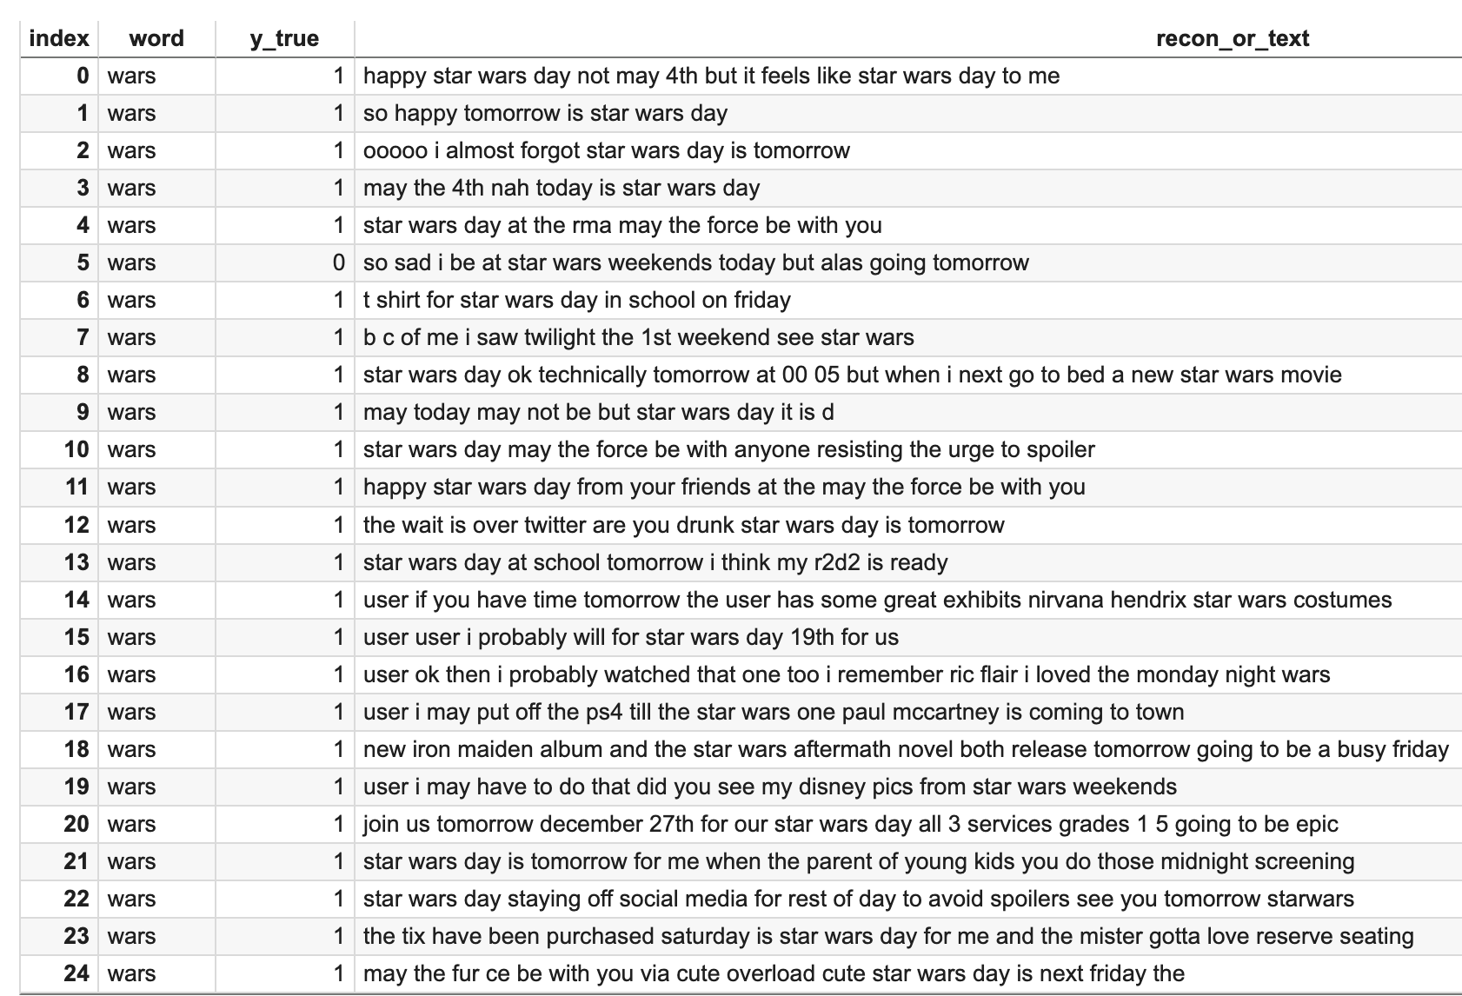
Twitter Top word case studies

Slide 49

IMDB Movie dataset: (50000, 3)

Slide 50

IMDB Dataset Snap

Slide 51

IMDB Training Accuracy

Slide 52

IMDB Training Results

Slide 53


IMDB Top 50 Positive and negative Words

Slide 54

IMDB Top word Case Studies

Slide 55

IMDB Top Word Case Studies

Slide 56
AMIC model Comparison Table
 | Training | Validation | Test
Wine | 90 | 88 | 88.6
Amazon | 97 | 94 | 94
Twitter | 90 | 85 | 86
IMDB | 91 | 88 | 88

Slide 57

ChatGPT Model: Sentiment Interpretation Neural Network

Slide 58



Wine Review Dataset

Slide 59

Find the best validation threshold and evaluate

Slide 60


Contextual Word Sentiment Scores

Slide 61

One Single Review Word Sentiment

Slide 62



IMDB Dataset

Slide 63

Find the best validation threshold and evaluate

Slide 64


IMDB Contextual Word Sentiment Scores

Slide 65

One Single Review Word Sentiment

Slide 66



Twitter Dataset

Slide 67

Find the best validation threshold and evaluate

Slide 68


Contextual Word Sentiment Scores

Slide 69

One Single Review Word Sentiment

Slide 70



Amazon Dataset

Slide 71

Find the best validation threshold and evaluate

Slide 72


Contextual Word Sentiment Scores

Slide 73

One Single Review Word Sentiment

Slide 74
SINN Model Comparison on different data
SINN | Training | Validation | Test
Wine | 89 | 87 | 88
Amazon | 93 | 89 | 89
Twitter | 92 | 87 | 88
IMDB | 94 | 89 | 90
Bayesian AMIC | Training | Validation | Test
Wine | 89 | 88 | 89
Amazon | 90 | 88 | 88
Twitter | 90 | 85 | 86
IMDB | 91 | 88 | 88

Slide 75

roberta-base model on Twitter Dataset: Split sizes: 25936, 3242, 3242

Slide 76

roberta-base model on Wine dataset: Split sizes: 113523, 14190, 14191

Slide 77

roberta-base model on Amazon dataset: Split sizes: 64000 8000 8000

Slide 78

roberta-base model on IMDB dataset: Split sizes: 40000 5000 5000

Slide 79
roberta-base model comparison on different data
 | Training | Validation | Test
Wine | 91 | 88 | 88
Amazon | 99 | 94 | 94
Twitter | 98 | 92 | 93
IMDB | 97 | 85 | 84

Slide 80
Oct. 2nd Update

Slide 81

Back to sentiment block top word selection

Slide 82
A few new preprocessing work to wine review
Remove the tailing part such as “Drink now. 5,000 cases made.”
Change to right padding from left padding to prioritize the sentiment tokens
Change padding size to 56 from 100 to speed up the training

Slide 83

Original Wine Review

Slide 84

After trimming the tails

Slide 85


Re-evaluate the coverage padding size: 56

Slide 86

A few changes to embedding training
ensures PAD row stays zeroed and ignored in gradients
Pre-train embeddings are trainable instead of freezing

Slide 87
A few changes to mask_block class
There is a big problem about learned mask scores previously: the learned mask scores are very tiny close to zero
Now we added the embedding norm layer to normalize the word-level embeddings
A unconstrainted linear layer with bias to train the sentiment scores
Finally sigmoid function to project the sentiment logits between 0 and 1

Slide 88

New Mask Block forward function

Slide 89

A few changes to training process
At the end of each epoch, we added the early stopping code if the validation accuracy does not improve for a pre-determined times
Given the new version of PyTorch, we do the optimizer step first then right after do schedule step to give more subtle control of gradients

Slide 90

Training Results

Slide 91
A few changes to select top words
We select words unconditional class top words by sentiment calibration
Select words by sentiment block scores, mean_mu
Automatically calibrate sign
Re-rank words by weighted mean_mu = mean_mu * word_count
For each word, we added positive count, negative counts, proportion of positive reviews, proportion of negative reviews

Slide 92

Top wine positive words

Slide 93

Top wine negative words

Slide 94

Investigate suspicious top words: ‘2032’

Slide 95

Top twitter positive words

Slide 96

Top twitter negative words

Slide 97

Investigate suspicious top positive word: ‘xxl’

Slide 98

Investigate suspicious top negative words: ‘charlie’

Slide 99

Top IMDB positive words

Slide 100

Top IMDB negative words

Slide 101

Investigate suspicious positive word: ‘zany’

Slide 102

Investigate IMDB negative word: ‘2’

Slide 103

Top Amazon Positive Words

Slide 104

Top Amazon negative words

Slide 105
Update Oct. 9th

Slide 106

A few changes
Remove all year trailing
Reweight top positive sentiment word by proportion of positive counts

Slide 107

New diagram

Slide 108

Wine Review Top Positive words

Slide 109

Wine Review Top Negative Words

